Slide 1

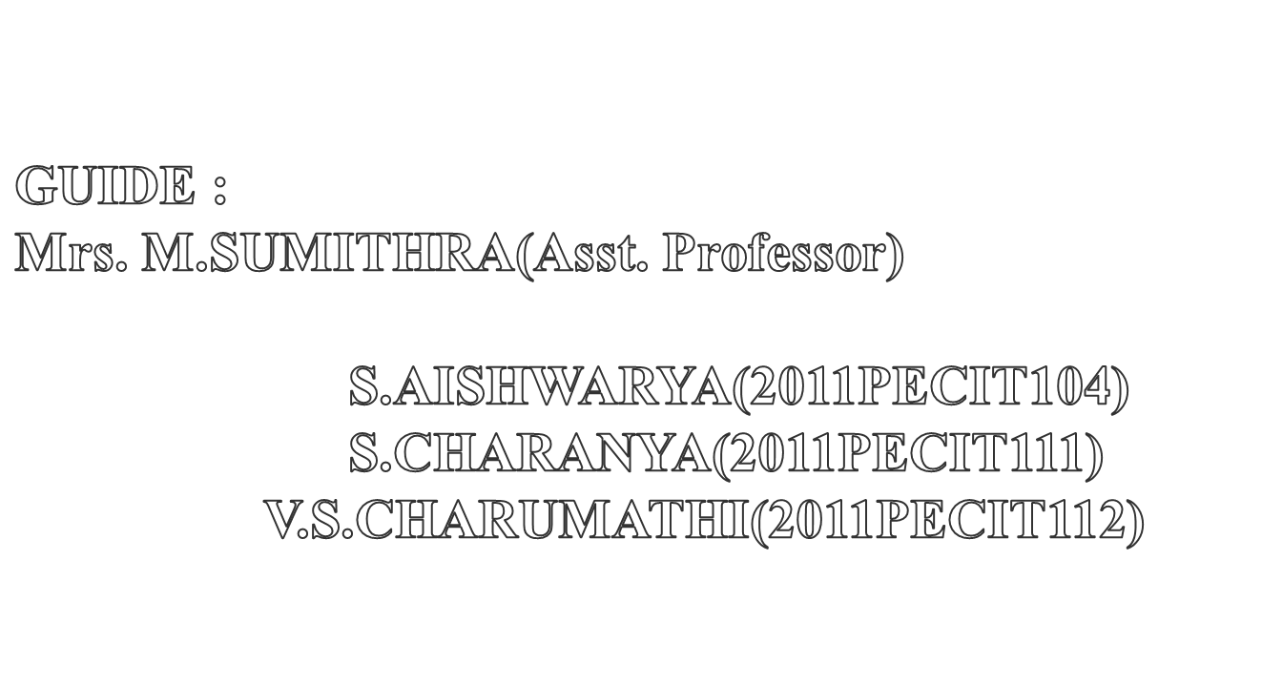

Slide 2

The vehicle accident & theft are a major public problem in many countries, particularly in India & Thailand.
In Biometric authentication only the authorized person is passed & vehicle ignition will be initiated.
If any other person rather than the authorized person is trying to access responsive GSM will be initiated & only the authorized person can give the permission rights.

Slide 3


Slide 4
AUTHOR/YEAR | TITLE | OBJECTIVES | DRAWBACKS
Shenglin Yang , Ingrid M. Verbauwhede UCLA Dept. of EE / 2003 | SECURE FINGERPRINT MATCHING TECHNIQUE | To propose a secure fingerprint matching technique, which is secure against side channel attacks. This is done by dividing the fingerprint recognition system into secure and non-secure parts. | Only part of the fingerprint is used which results in single function.
Koichi Ito, Ayumi Morita, Takafumi Aoki, Tatuso Higuchi, Hiroshi Nakajima, Koji Kobayashi/ 2005 | A Fingerprint Recognition Algorithm Using Phase-Based Image Matching for Low-Quality | To achieve highly robust fingerprint recognition for low-quality fingerprints using fingerprint recognition algorithm. | It is less secure against side channel attacks. It is prone to transmission errors.

Slide 5
AUTHOR/YEAR | TITLE | OBJECTIVES | DRAWBACKS
Yen wang, Hong liu, Jun feng/ 2009 | The Design of an Intelligent Security Access Control System Based on Fingerprint Sensor FPC1011C | A fingerprint acquisition module and a wireless alarm module is used is used to provide intelligent sec. access control using GSM and GPRS. | Owner cannot control the access of the vehicle
Omidiora E. O. , Fakolujo O. A. , Arulogun O. T. , Aborisade D. O. / 2010 | A Prototype of a fingerprint based ignition systems in vehicles | Implementing the concept of finger print in vehicles for the purpose of ignition. | Chances of faking the finger print is possible.
N. Kiruthiga1 and L. Latha2 M.E /2010 | A Study of Biometric Approach for Vehicle Security System Using Fingerprint Recognition | To implement a competent automotive security system using embedded system along with Global System for Mobile (GSM) and Fingerprint Recognition for automatic person identification. | Only used for tracking and monitoring the vehicle.

Slide 6
AUTHOR/YEAR | TITLE | OBJECTIVE | DRAWBACKS
Jiwa Abdullah /2011 | The Design of Mobile Control Car Security System | Based on the GSM positioning concept, this system has the potential to provide car location information to assist in stolen vehicle recovery therefore providing enhancement over the conventional car alarm system. | In this system , the car owner can control the features of the car using GSM that involves phone call and no alert message is provided.
1Jayapriya.P, 2Prof. Prabhakaran.S, 3Ashok T.1ME-EST, 2Assistant Professor Nandha Engineering College, Erode. /2012 | Intelligent Vehicle Control for Driver Behaviour using Wireless in Transportation System | To provide multiple levels of security using GSM, GPS receiver, alcohol and heartbeat sensors,eyeblink sensors, RFID reader and accident sensors | This involves the use of more instruction sets Practical implementation was not very successful as it is more complex
Hnin Pwint Han, Hla Myo Tun /2012 | Advanced Car Security System Using GSM | This system proposes the design and construction of an advanced car security system using GSM using SMS protocol available in the mobile phone | The car owner cannot control the features of the car using reversible GSM as it is not supported.

Slide 7
AUTHOR/YEAR | TITLE | OBJECTIVES | DRAWBACKS
Subhani SK.M, Sateesh G.N.V, Chaitanya C.H, Prakash Babu C. / 2013 | Implementation of GSM Based Heart Rate and Temperature Monitoring System | To provide security of using temp. monitoring system and heart rate detection using sensors | More technology is required for wireless transmission High cost
Ajinkya Kawale / 2013 | Fingerprint based locking system | To overcome the inconveniences of the conventional fingerprint system using Fingerprint recognition technology that allows access to only those whose fingerprints are pre stored in the memory | No notification is given to the owner in case of unauthorized access

Slide 8

In the existing system, the authentication is done using fingerprint for the purpose of ignition in two wheelers.
It provides security for the two wheeler from being theft.
The fingerprint detection algorithm used is minutiae, ridge, image based matching.
It can store up to 768 fingerprints.
It eliminates the use of keys.
It provides highly secure fingerprint identification and enrollment in database.

Slide 9

Existing security principle for the vehicles uses remote control access technology.
No strong security systems designed so far.
So car thefts have increased in large numbers.
The finger print technique is used only for the purpose of ignition.

Slide 10
The finger print concept is used in the door lock itself for the purpose of car theft.
The reversible GSM technique is used to grant access to the authorized person through messages.
The location of the vehicle can be found using GPS and sent to nearby police station and owner in case of car theft.
The motion of the vehicle can be controlled by the authorized person using the reversible GSM concept.
Various sensors such as seatbelt, door lock, alcohol are used.

Slide 11

To prevent vehicle theft, accidents and also enhancing security.
(ie).Only the Authorized person are allowed to access the respective vehicles.
To provide safety and security concept to the drivers with the help of embedded systems.
To find the current location of the vehicle and to allow the authorized person to control the motion of the vehicle.

Slide 12

Hi-tech Compiler
Embedded C
MP LAB

Slide 13

Microcontroller
ADC
Alcohol sensor
IR sensor
Relay
Biometric sensor
LCD
GSM

Slide 14
Power supply
GSM
Door lock Sensor
PIC
CONTROLLER
IR sensor for seat belt detection
Gas sensor
Relay
MOTOR
Biometric authentication
LCD

Slide 15
The uniqueness of this project is responsive GSM technique.
In responsive GSM, a message will be sent to the owner in case of unauthorized person accessing the car.
In turn, the owner replies to it with a password through which we can grant access to the unauthorized person.
This technique allows us to grant access to those whose fingerprint is not stored in the database.

Slide 16

PIC Microcontroller
Fingerprint
Seat belt sensor
Heart beat sensor
Alcohol sensor

Slide 17


Slide 18

In the pic module, the power supply voltage will be compressed to 12 V digital supply.
That through bridge wave rectifier will be sent to the microcontroller.
The 2.5v will be given as input to PIC and output from it will also be somewhere near 2-2.5v.

Slide 19
Module 1:
Start
2300 A.C
St
TRN
2 Volt A.C
B.W.R
µ.c
Stop

Slide 20

In this module, we can enroll, identify, delete the fingerprints stored in PIC.
We can enroll upto 255 fingerprints.
If an unauthorized person access the vehicle, then an alert message will be sent to the owner.
The owner can grant access by replying to the message with the password.
The user can open the door only if this module is authenticated.

Slide 21
Start
Fingerprint sensor
Finger matched?
Alert msg
no
yes
Door unlocks
Permit?
yes
Door unlocks
no
Door locked
Stop

Slide 22

For checking the condition of seatbelt, the IR sensor is used.
If the seatbelt is locked only then the engine will be started.
Otherwise the engine will be off.
Once the seatbelt is checked it will check the heat beat rate.

Slide 23
Module 3:
Start
If seatbelt is worn
Motor in off state
no
Yes
Motor on
Stop

Slide 24

This sensor checks the heart beat rate of the driver.
The sensor will be kept at the back rest of the driver seat.
Once the seat belt is locked the driver’s heart rate will be checked when he rests back.
If the rate is less than 72 then it will be considered as low pressure and the vehicle speed will be reduced.
If the rate is above or equal to 72 then it will be allowed to run in normal speed.

Slide 25
Module 4:
Start
Biometric sensor
If H.B > 72
yes
Normal speed
no
Decelerate speed
Stop

Slide 26

This sensor is used to check the alcohol level of the driver.
If alcohol is detected then the entire system will shut down. The engine will not start.
It is the last check for the vehicle to start.
If this is cleared then the engine will start and the vehicle will run.
The heartbeat sensor will keep checking throughout the system.

Slide 27
Module 5:
Start
Alcohol sensor
If alcohol detected
System off
Yes
System on
Stop

Slide 28
#include <AT89X52.H>
#include "smcl_lcd8.h"
#include "AT_serial.h"
sbit ent=P1^0;
sbit inc=P1^1;
sbit dec=P1^2;
sbit set=P1^2;
unsigned char rc=0,data_rcv[86],i,fp_id,fpid1,count=0,chk_sum,va,k=0;
bit chk0,chk1,chk2;
void fpid(unsigned char val);
void ent_fpid();
void result();
void fd()
{
Lcd8_Command(0x01);
// Lcd8_Display(0x80,"Finger Print ",16);
Lcd8_Display(0xc0,"Welcome ",16);
}

Slide 29
void display(unsigned char val)
{
switch(val)
{
case 1:
Lcd8_Display(0xc0,"--Enrl Usr FP.--",16);
break;
case 2:
Lcd8_Display(0xc0,"--identify FP.--",16);
break;
case 3:
Lcd8_Display(0xc0,"--Del All FP.---",16);
break;
default:
fd();
break;
}
}

Slide 30
void Serial() interrupt 4
{
if(RI)
{
RI=0;
data_rcv[rc]=SBUF;
rc++;
}
}
void txs(unsigned char val)
{
Serial_Out(val);
}
void delay1()
{
long i;
for(i=0;i<50000;i++);
}

Slide 31
void delay2()
{
int i;
for(i=0;i<15000;i++);
}
void delay3(unsigned int del)
{
while(del--);
}
void sendd1()
{
txs('A');txs('T');txs('+');txs('C');txs('M');txs('G');
txs('S');txs('=');
txs('"');
txs('9');txs('7');txs('8');txs('9');
txs('7');txs('2');txs('8');txs('7');txs('9');txs('0');
txs('"');
txs(13); txs(10);
delay3(60000); delay3(60000);delay3(60000); delay3(60000);delay3(60000); delay3(60000);
}

Slide 32
void sms1()
{
sendd1(); delay3(10000);
txs('A');txs('l');txs('e');txs('r');txs('t');
txs(26);
delay3(60000); delay3(60000);delay3(60000); delay3(60000);delay3(60000); delay3(60000);
}
void sendd()
{
txs('A');txs('T');txs(13);txs(10);
delay1();
txs('A');txs('T');txs('+');txs('C');txs('M');txs('G');
txs('S');txs('=');
txs('"');
txs('9');txs('7');txs('8');txs('9');
txs('7');txs('2');txs('8');txs('7');txs('9');txs('0');
txs('"');
txs(10);
txs(13);
Delay(60000); Delay(60000);Delay(60000);Delay(60000);Delay(60000);
}

Slide 33
void sms()
{
sendd();
txs('A');txs('l');txs('e');txs('r');txs('t');
txs(10);
txs(13);
txs(26);
Delay(60000);
}
unsigned char rxs()
{
int c=0;
while(RI==0)
{
c++;
if(c>25000)
break;
}
RI=0;
return SBUF;
}

Slide 34
void rxmo()
{
char i;
txs('A');txs('T');txs('+');txs('C');txs('M');txs('G');
txs('R');txs('=');txs('1');txs(13); txs(10);
for(i=0;i<86;i++)
{
data_rcv[i]=rxs();
}
}
void del1()
{
char i;
txs('A');txs('T');txs('+');txs('C');txs('M');txs('G');
txs('D');txs('=');txs('1');txs(13); txs(10);
for(i=0;i<13;i++)
{
data_rcv[i]=rxs();
}
}

Slide 35
void main()
{
Lcd8_Init();
EA=1;
SCON=0x50;
PCON=PCON | 0x80;
TMOD=0X20;
TH1=0XFf;
TR1=1;
txs('A');txs('T');txs(13);txs(10);
delay1();
txs('A');txs('T');txs('+');txs('C');txs('M');txs('G');
txs('F');txs('=');txs('1');txs(13);txs(10);
Delay(60000);
del1();
Lcd8_Display(0x80,"Show Finger ",16);
fd();
Receive(1);
Delay(65000);

Slide 36
for(k=0;k<=80;k++)
{
data_rcv[k]=0;
}
while(1)
{
if(!inc && !chk0)chk0=1;
if(inc && chk0){count++;if(count>5)count=0;chk0=0;}
if(!ent && !chk1)chk1=1;
if(ent && chk1){chk1=0;fpid(count);}
if(!dec && !chk2)chk2=1;
if(dec && chk2){count--;if(count>5)count=5;chk2=0;}
display(count);
if(rc>10)
{
for(k=0;k<=49;k++) //11
{
Lcd8_Decimal3(0xc0,data_rcv[k]);

Slide 37
Delay(6500);
}
Lcd8_Decimal3(0x80,data_rcv[49]);//
Lcd8_Decimal3(0x85,data_rcv[47]);
Lcd8_Decimal3(0x8c,rc);
Delay(6500);
result();
rc=count=0;
for(k=0;k<=80;k++)
{
data_rcv[k]=0;
}
}
}
}

Slide 38
void fpid(unsigned char val)
{ Lcd8_Display(0xc0,"--Processing.---",16);
for(rc=0;rc<50;rc++)data_rcv[rc]=0;
rc=0;
switch(val)
{ case 1: ent_fpid();
Serial_Conout("\xEF\x01\xFF\xFF\xFF\xFF\x01\x00\x03\x01\x00\x05",12);
Delay(65000);Delay(65000);
Serial_Conout("\xEF\x01\xFF\xFF\xFF\xFF\x01\x00\x04\x02\x01\x00\x08",13);
Delay(65000);Delay(65000);
Serial_Conout("\xEF\x01\xFF\xFF\xFF\xFF\x01\x00\x03\x01\x00\x05",12);
Delay(65000);Delay(65000);
Serial_Conout("\xEF\x01\xFF\xFF\xFF\xFF\x01\x00\x04\x02\x02\x00\x09",13);
Delay(65000);Delay(65000);
Serial_Conout("\xEF\x01\xFF\xFF\xFF\xFF\x01\x00\x03\x05\x00\x09",12);
Delay(5000);
Serial_Conout("\xEF\x01\xFF\xFF\xFF\xFF\x01\x00\x06\x06\x02",11);
Serial_Out(0);
Serial_Out(fp_id);
chk_sum=fp_id+15;
Serial_Out(0);
Serial_Out(chk_sum);
Delay(65000);Delay(65000);Delay(65000) ;
i=1;
break;

Slide 39
case 2:
Serial_Conout("\xEF\x01\xFF\xFF\xFF\xFF\x01\x00\x03\x01\x00\x05",12); //read or search
Delay(65000);Delay(65000);Delay(40000);//Delay(30000);
Serial_Conout("\xEF\x01\xFF\xFF\xFF\xFF\x01\x00\x04\x02\x01\x00\x08",13);//read
Delay(40000);Delay(20000);//Delay(10000);
Serial_Conout("\xEF\x01\xFF\xFF\xFF\xFF\x01\x00\x08\x1b\x01\x00\x00\x01\x01\x00\x27",17);//read
Delay(65000);Delay(65000);i=2;
break;
case 3://EF 01 FF FF FF FF 01 00 03 0D 00 11
Serial_Conout("\xEF\x01\xFF\xFF\xFF\xFF\x01\x00\x03\x0D\x00\x11",12);
i=4;
break;
default:
break;
}
fd();
}

Slide 40
void ent_fpid()
{
Lcd8_Display(0x80,"Enter ID No: 000",16);
fp_id=0;
while(ent)
{
if(!inc){while(!inc);fp_id++;if(fp_id>=255)fp_id=0;Lcd8_Decimal3(0x8D,fp_id);}
if(!dec){while(!dec);fp_id--;if(fp_id>=255)fp_id=255;Lcd8_Decimal3(0x8D,fp_id);}
}
}
void result()
{
char flg=0,hbt=0,hbtt=0,hb=0,f1=0;
Lcd8_Command(0x01);
Delay(65000);
if(i==1)
{
if((data_rcv[69]==0x00)&&(rc>70))
{
Lcd8_Display(0xC0," Success ",16);
}

Slide 41
else if(data_rcv[69]==0x02)
{
Lcd8_Display(0x80," No Finger ",16);
}
else
{
Lcd8_Display(0xC0," Not Success ",16);
}
i=0;
}
else if(i==2)
{
if((data_rcv[33]==0x00)&&(data_rcv[35]!=0))
{
Lcd8_Display(0x80," Success ",16);
Lcd8_Display(0xc0," Finger ID: ",16);
Lcd8_Decimal3(0xcb,data_rcv[35]);
Lcd8_Display(0x80,"IR SENSOR ",16);
while(P0_6==1)
{
}

Slide 42
while(1)
{
// Lcd8_Display(0x80,"Vibration ",16);
//while(P3_5==1)
//{
//}
Lcd8_Display(0xc0,"ALCOHOL CHECK ",16);
if(P0_7==1)
{
Lcd8_Display(0xc0,"ALCOHOL DETECTED ",16);
sms();
while(1);
}
if(P0_5==1)
{
if(flg==0)
if(hbt<100)
{
hbt++;
flg=1;
}
}

Slide 43
if(P0_5==0)
{
flg=0;
}
hb++;
if(hb==120)
{
hbtt=hbt*3;
hbt=0;
hb=0;
}
Lcd8_Command(0x80);
Lcd8_Write(0x80,'H');
Lcd8_Write(0x81,'e');
Lcd8_Write(0x82,'a');
Lcd8_Write(0x83,'r');
Lcd8_Write(0x84,'t');
Lcd8_Write(0x85,' ');
Lcd8_Write(0x86,'B');
Lcd8_Write(0x87,'t');
Lcd8_Write(0x88,'=');
Lcd8_Write(0x89,((hbtt/100)+0x30));
Lcd8_Write(0x8a,(((hbtt%100)/10)+0x30));

Slide 44
Lcd8_Write(0x8B,((hbtt%10)+0x30));
Lcd8_Write(0x8c,' ');
Lcd8_Write(0x8d,((hbt/100)+0x30));
Lcd8_Write(0x8E,(((hbt%100)/10)+0x30));
Lcd8_Write(0x8F,((hbt%10)+0x30));
if(hbtt>10)
{
if(hbtt<50)
{ if(f1==0)
{
sms();
P0_1=0;
f1=1;
}
}
else
{
f1=0;
P0_1=1;
}
}
} }

Slide 45
else //if(data_rcv[33]==0x09)
{
sms1();
P0_0=0;
Lcd8_Display(0x80,"Not Find Finger ",16);
ES=0;
while(1)
{ rxmo();
delay1();
delay1();
Lcd8_Write(0xc0,data_rcv[72]);
Lcd8_Write(0xc1,data_rcv[73]);
Lcd8_Write(0xc2,data_rcv[74]);
Lcd8_Write(0xc3,data_rcv[75]);
Lcd8_Write(0xc4,data_rcv[76]);
Lcd8_Write(0xc5,data_rcv[77]);
Lcd8_Write(0xc6,data_rcv[78]);
Lcd8_Write(0xc7,data_rcv[79]);
Lcd8_Write(0xc8,data_rcv[80]);
Lcd8_Write(0xc9,data_rcv[81]);
Lcd8_Write(0xcA,data_rcv[82]);
Lcd8_Write(0xcB,data_rcv[83]);
Lcd8_Write(0xcC,data_rcv[84]);

Slide 46
Lcd8_Write(0xcD,data_rcv[85]);
if(data_rcv[75]=='H')
{
del1();
delay1();
Lcd8_Display(0x80,"IR SENSOR ",16);
while(P0_6==1)
{ }
while(1)
{
// Lcd8_Display(0x80,"Vibration ",16);
//while(P3_5==1)
//{
//}

Slide 47
Lcd8_Display(0xc0,"ALCOHOL CHECK ",16);
if(P0_7==1)
{
Lcd8_Display(0xc0,"ALCOHOL DETECTED ",16);
sms();
while(1);
}
if(P0_5==1)
{
if(flg==0)
if(hbt<100)
{
hbt++;
flg=1;
}
}
if(P0_5==0)
{
flg=0;
}
hb++;

Slide 48
if(hb==120)
{
hbtt=hbt*3;
hbt=0;
hb=0;
}
Lcd8_Command(0x80);
Lcd8_Write(0x80,'H');
Lcd8_Write(0x81,'e');
Lcd8_Write(0x82,'a');
Lcd8_Write(0x83,'r');
Lcd8_Write(0x84,'t');
Lcd8_Write(0x85,' ');
Lcd8_Write(0x86,'B');
Lcd8_Write(0x87,'t');
Lcd8_Write(0x88,'=');
Lcd8_Write(0x89,((hbtt/100)+0x30));
Lcd8_Write(0x8a,(((hbtt%100)/10)+0x30));
Lcd8_Write(0x8B,((hbtt%10)+0x30));
Lcd8_Write(0x8c,' ');
Lcd8_Write(0x8d,((hbt/100)+0x30));
Lcd8_Write(0x8E,(((hbt%100)/10)+0x30));
Lcd8_Write(0x8F,((hbt%10)+0x30));

Slide 49
if(hbtt>10)
{
if(hbtt<50)
{
if(f1==0)
{
sms();
P0_1=0;
f1=1;
}
}
else
{
f1=0;
P0_1=1;
}
}
}
}
if(data_rcv[85]=='H')
{
del1();
delay1();

Slide 50
Lcd8_Display(0x80,"IR SENSOR ",16);
while(P0_6==1)
{
}
while(1)
{
// Lcd8_Display(0x80,"Vibration ",16);
//while(P3_5==1)
//{
//}
Lcd8_Display(0xc0,"ALCOHOL CHECK ",16);
if(P0_7==1)
{
Lcd8_Display(0xc0,"ALCOHOL DETECTED ",16);
sms();
while(1);
}

Slide 51
if(P0_5==1)
{
if(flg==0)
if(hbt<100)
{
hbt++;
flg=1;
}
}
if(P0_5==0)
{
flg=0;
}
hb++;
if(hb==120)
{
hbtt=hbt*3;
hbt=0;
hb=0;
}
Lcd8_Command(0x80);
Lcd8_Write(0x80,'H');
Lcd8_Write(0x81,'e');
Lcd8_Write(0x82,'a');

Slide 52
Lcd8_Write(0x83,'r');
Lcd8_Write(0x84,'t');
Lcd8_Write(0x85,' ');
Lcd8_Write(0x86,'B');
Lcd8_Write(0x87,'t');
Lcd8_Write(0x88,'=');
Lcd8_Write(0x89,((hbtt/100)+0x30));
Lcd8_Write(0x8a,(((hbtt%100)/10)+0x30));
Lcd8_Write(0x8B,((hbtt%10)+0x30));
Lcd8_Write(0x8c,' ');
Lcd8_Write(0x8d,((hbt/100)+0x30));
Lcd8_Write(0x8E,(((hbt%100)/10)+0x30));
Lcd8_Write(0x8F,((hbt%10)+0x30));
if(hbtt>10)
{
if(hbtt<50)
{
if(f1==0)
{
sms();
P0_1=0;
f1=1;
}
}

Slide 53
else
{
f1=0;
P0_1=1;
}
}
}
}
}
}
// Serial_Init(9600);
i=0;
}
else if(i==3)
{
if(data_rcv[9]==0x00)
{
// Lcd8_Display(0x80," Finger Id ",16);
Lcd8_Display(0xc0," Deleted ",16);
}

Slide 54
else if(data_rcv[9]==0x10)
{
// Lcd8_Display(0xC0,"Fail To delete ",16);
// Lcd8_Display(0xc0," Finger Id ",16);
}
else if(data_rcv[9]==0x01)
{
// Lcd8_Display(0x80,"Receiving ",16);
Lcd8_Display(0xc0," Error ",16);
}
i=0;
}
else if(i==4)
{
if(data_rcv[9]==0x00)
{
Lcd8_Display(0xc0," Deleted ",16);
}
else if(data_rcv[9]==0x11)
{
// Lcd8_Display(0x80,"Fail To delete ",16);
// Lcd8_Display(0xc0,"Finger Id's ",16);
}

Slide 55
else if(data_rcv[9]==0x01)
{
// Lcd8_Display(0x80,"Receiving ",16);
// Lcd8_Display(0xc0," Error ",16);
}
i=0;
}
else if(i==5)
{
va=data_rcv[49]-data_rcv[47];
Lcd8_Decimal3(0xcA,va);
Delay(65000);Delay(65000);
//if(va==0x0c||va==12)
if(data_rcv[45]==0x00&&va==12)
{
// Lcd8_Display(0x80,"Matching ",16);
Lcd8_Display(0xc0," Success ",16);
}

Slide 56
else if(va==13)
{
//Lcd8_Display(0x80,"Receiving ",16);
Lcd8_Display(0xc0," Error ",16);
}
else
{
//Lcd8_Display(0x80,"Matching ",16);
Lcd8_Display(0xc0," Not Success ",16);
P3_7=1;
P3_5=0;
P0=0;
} i=0;
}
Delay(6500);
}

Slide 57

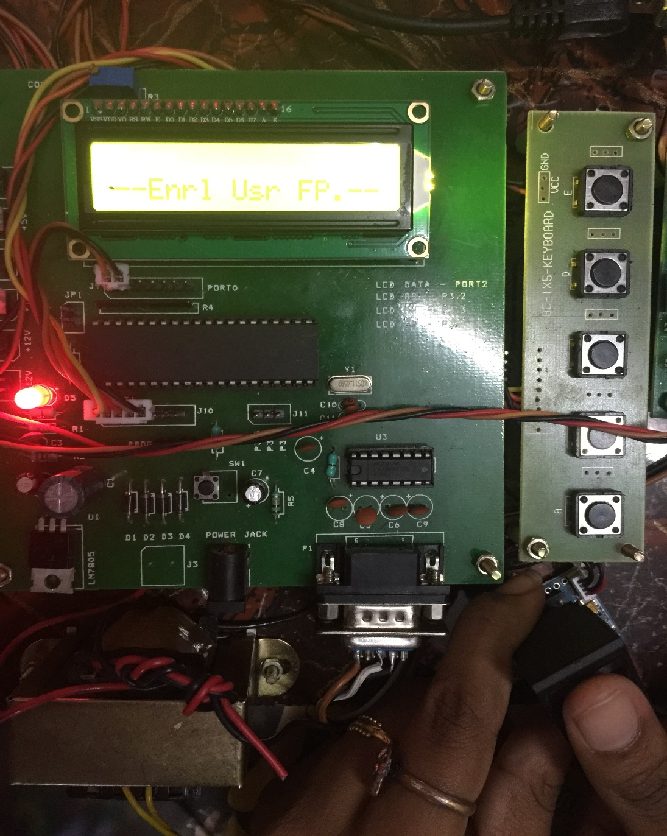
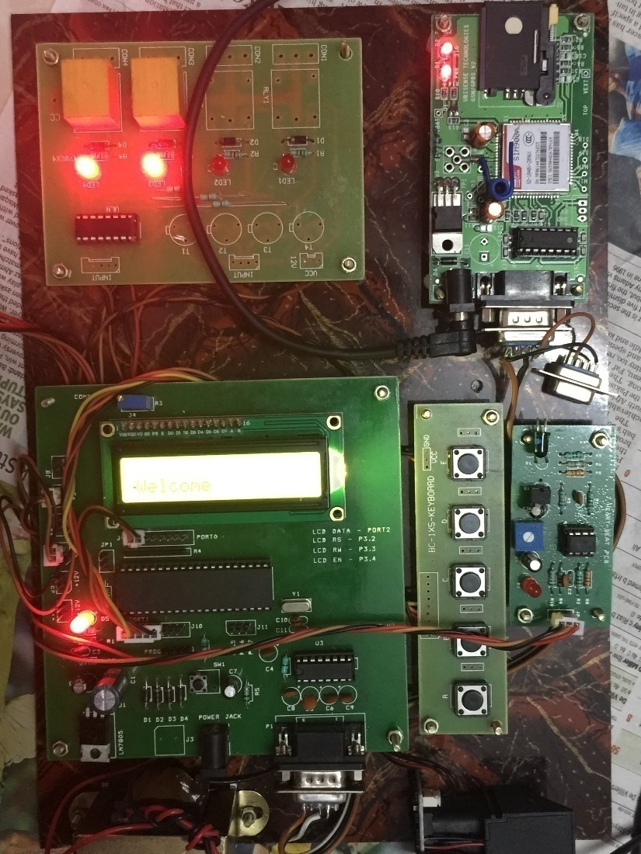

Slide 58
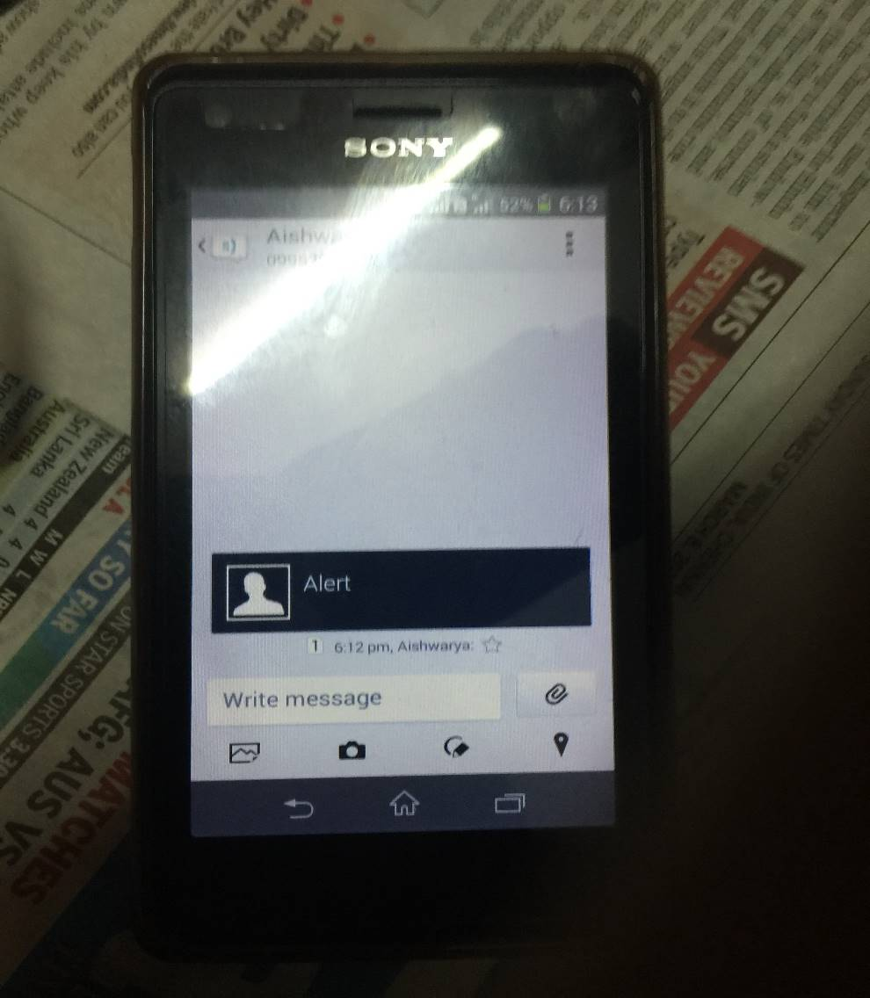
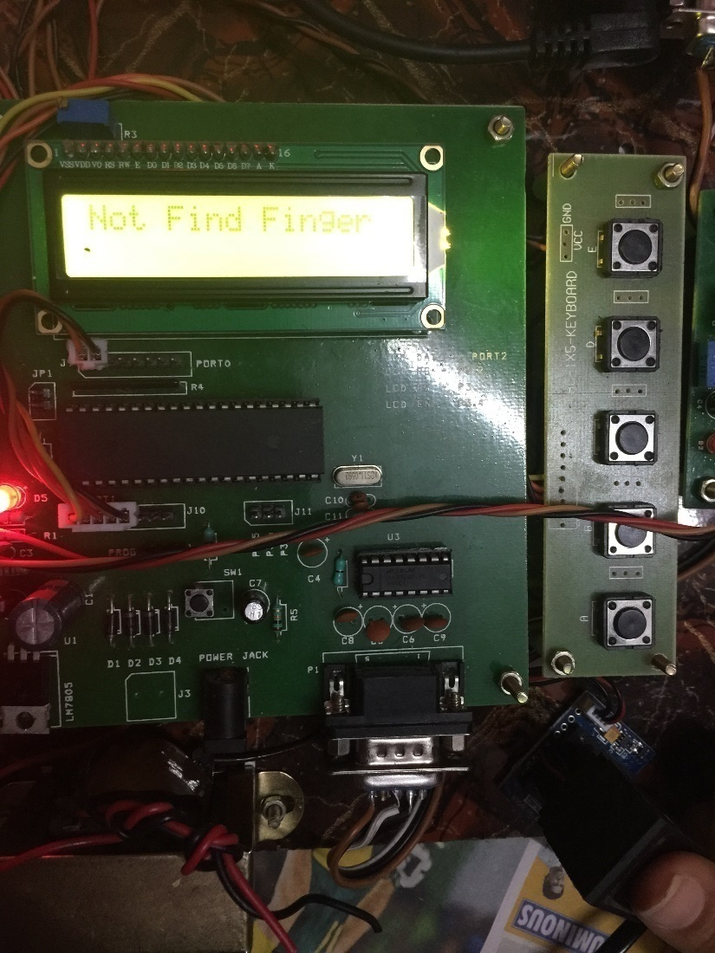

Slide 59
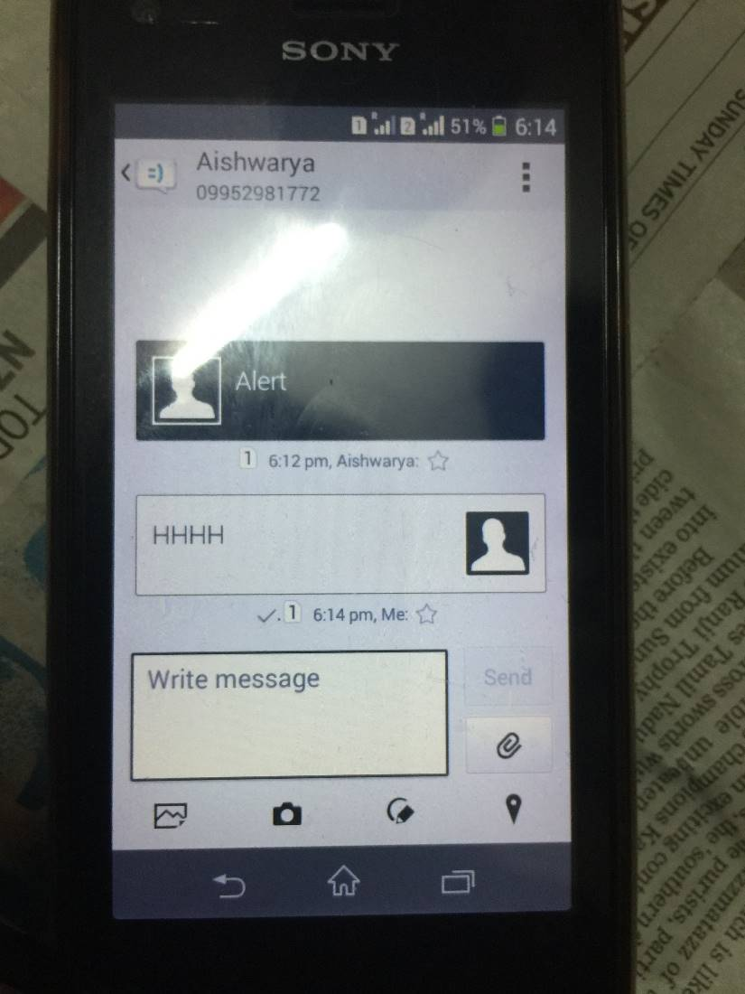
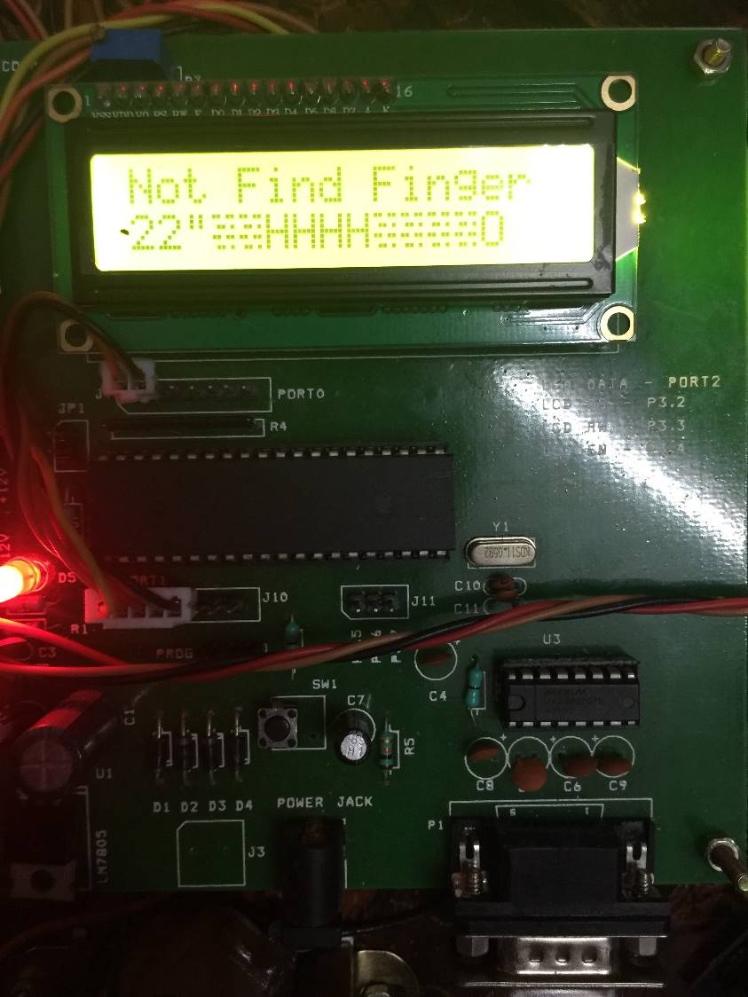

Slide 60
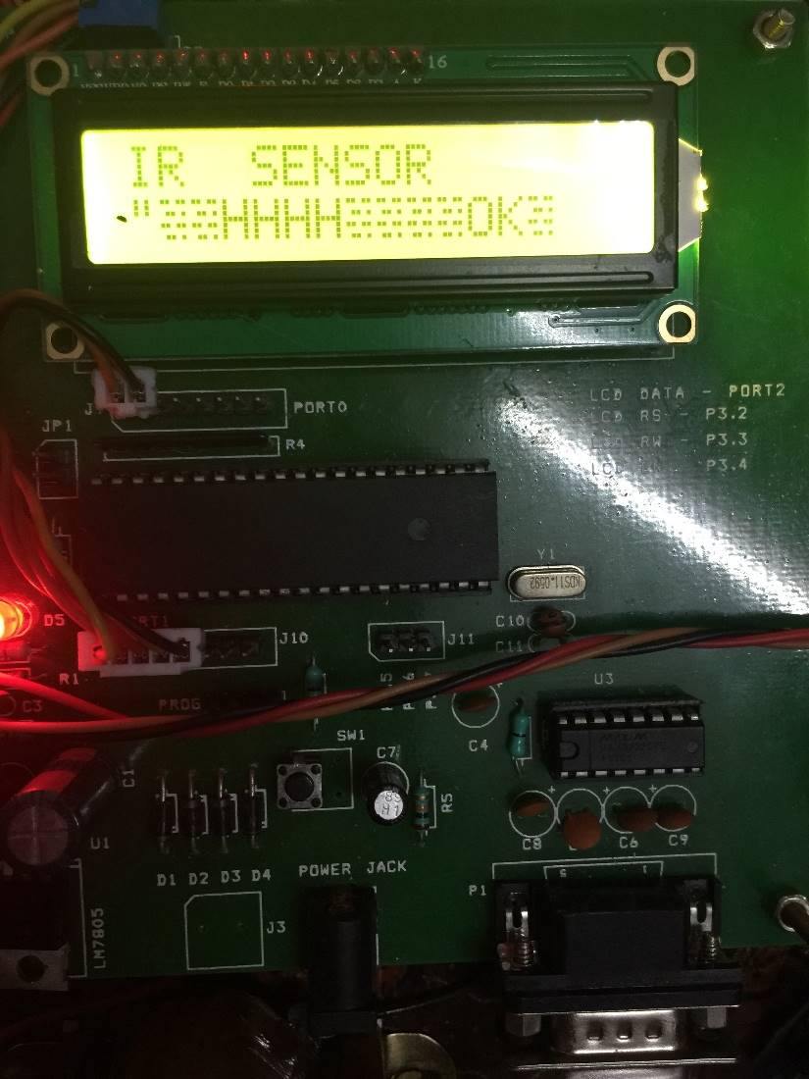
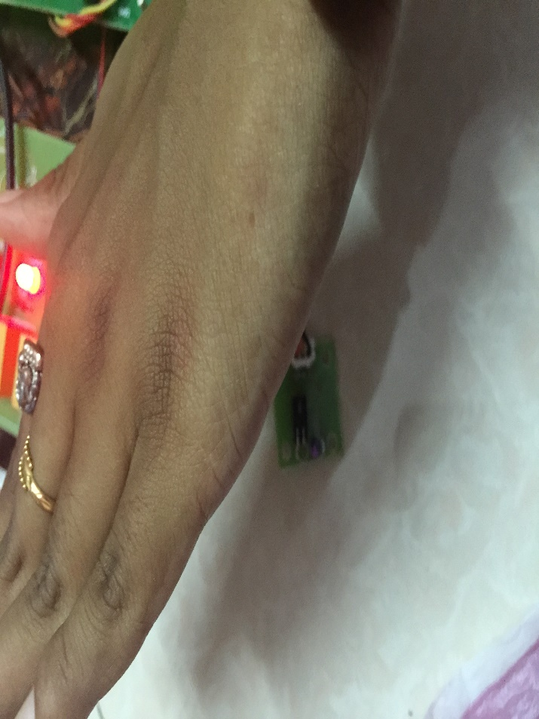

Slide 61
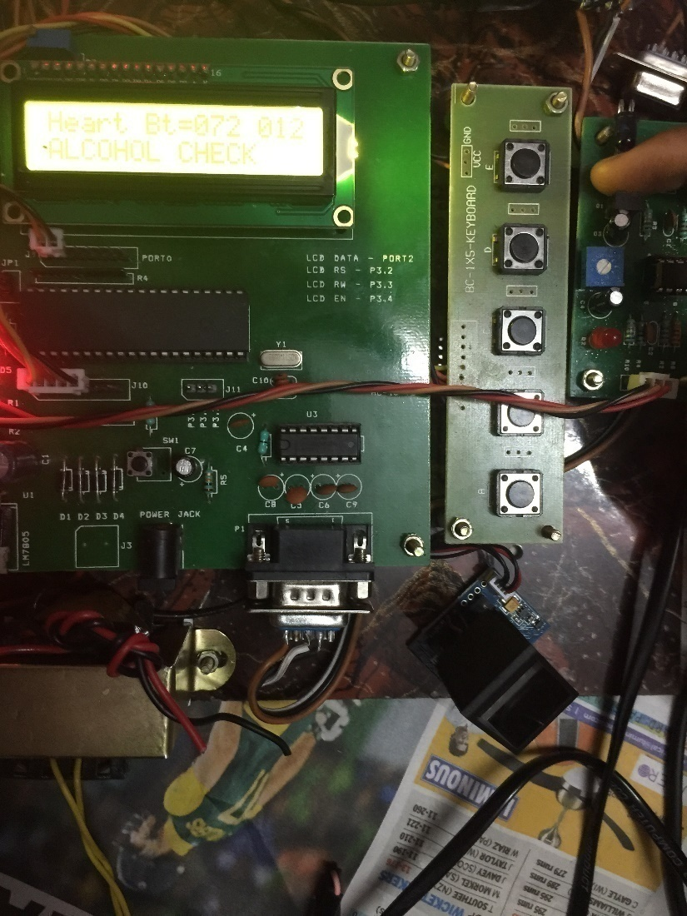
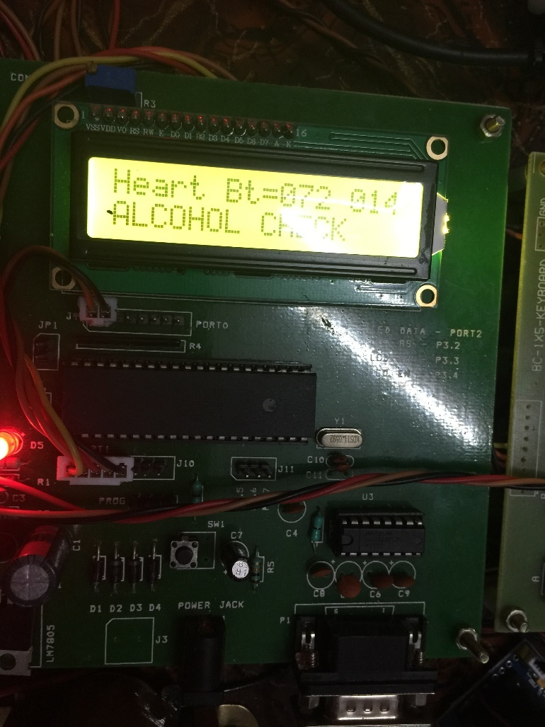

Slide 62
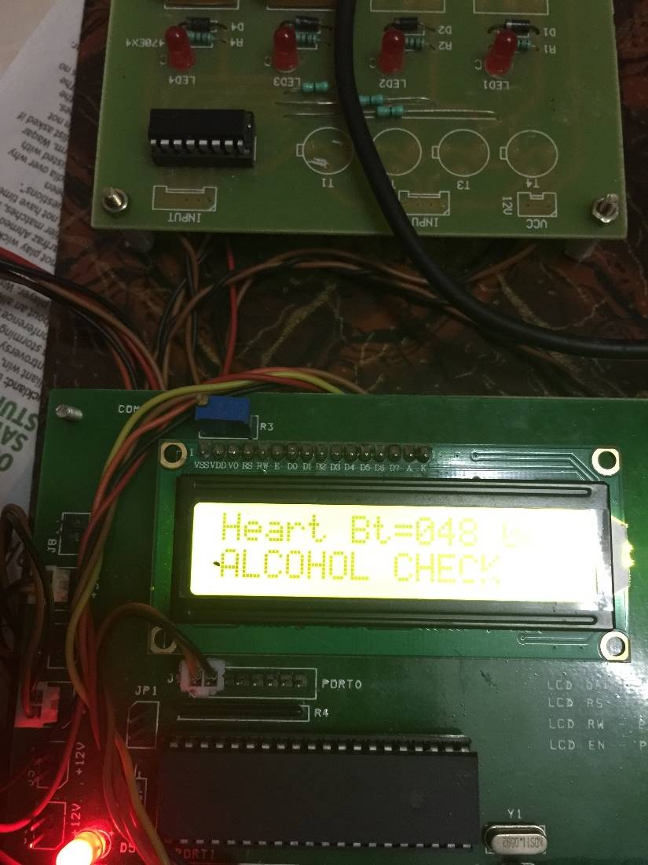

Slide 63
Government sector
Public sector
POS,ATMs
Other industry specific applications
Time and attendance
Slide 7

Slide 64


